Slide 1
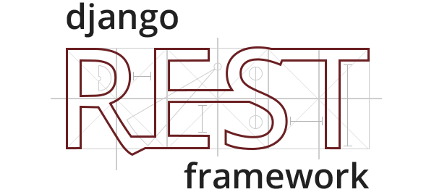
Introduction to Django-REST-Framework
Wladymir Brborich

Slide 2


Things to bare in mind
Which is your target platform?
What language do you like?
The language you like makes it easy to implement a REST api?
The features of the language you choosed optimize your workflow?
Are you building upon someone’s else code?
Do you have to work against the technology?
It accommodates your needs?

Slide 3

Types of frameworks (generally)
Opinionated
Somewhat Opinionated
Non Opinionated

Slide 4
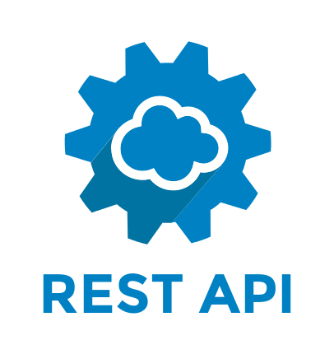
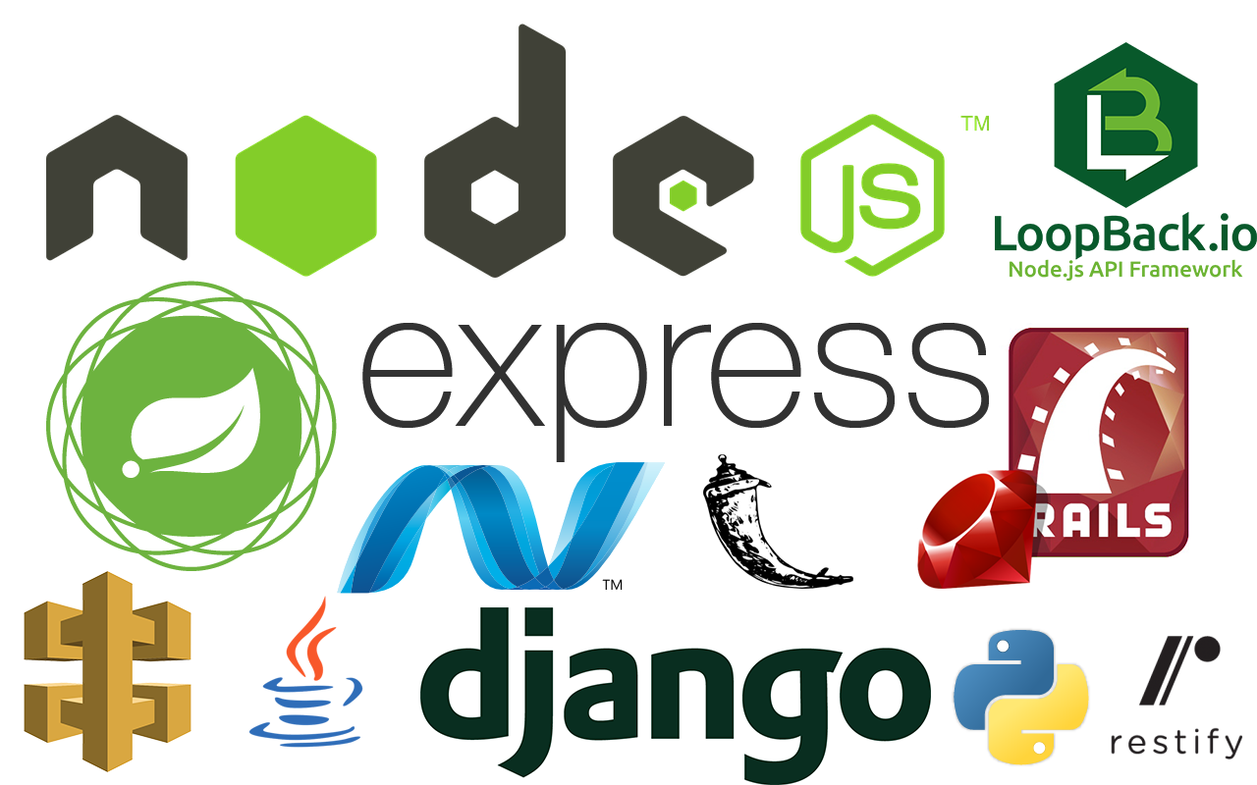
A few examples:
Java EE now Jakarta*
Django with Django-Rest-Framework
ASP .Net
Windows Communication Foundation*
Flask
Express with Node.js

Slide 5


Java EE
Robust, Easy enough when you know java
You have all the support from third-party libraries and code.
Widely spread
Mature
Heavy to load
Slow to deploy for testing.
Not comprehensive logs
If you want to build a serious system, you need to know more than just one framework

Slide 6
Django-Rest-Framework
Fast to deploy
The beauty of python
All tools included
Easy and fast to learn
The best for mockup’s
Not widely spread
You need to learn something new
Not great if you need to build from the ground up

Slide 7

Installation
You can learn more about it here: https://docs.djangoproject.com/en/2.1/topics/install/#installing-official-release
For now we will just use the command: pip install Django
And pip install djangorestframework

